Slide 1
Cybernetic Protectors
The main objective of Cybernetic Protectors is to provide a secure way of communication and transferring evidences in Secret Intelligence Agency of defence system which has always uses undercover agents to solve complex cases and dismantle criminal organizations.
We are conceptualizing this software as a solution so that Secret Intelligence Agencies and their agents can communicate through this Software for the exchange of evidences in a secure way. And maintain the details of Defence Minister.

Slide 2
Existing System:
This existing system is not providing secure registration and profile management of all the users properly.
This manual system gives us very less security for saving data and some data may be lost due to mismanagement.
The system is giving only less memory usage for the users.
The system doesn’t provide facility to track all the activities of Agency-Chief and under working Agents.
The system doesn’t provide any facility to maintain any tips & suggestion for Citizen.
The system doesn’t provide any functionality to upload evidences in encrypted format.
This system doesn’t provide recruitment of agents through online.
The system doesn’t provide any functionality to Defense Minister/Secrete Agency-Chief/Agents for online chatting.

Slide 3
Proposed System:
This system maintains user’s personal, address, and contact details.
User friendliness is provided in the application with various controls provided by system rich user interface.
This system makes the overall project management much easier and flexible.
Various classes have been used for maintain the details of all the users and catalog.
Authentication is provided for this application only registered users can access.
Report generation features is provided using to generate different kind of reports.
The system provides facilities to track the all activities of Agency-Chief and Agents.
System also tracks the tips and suggestion online.
System provides facility to recruit Agents in online.
System also provides facility to upload evidences in encrypted format and view cases, related resources.

Slide 4
Modules:-
1. Citizen
2. Under Cover Agent
3. Secret Intelligence Agency‘s chief
4. Ministry of Defense
5. Security And Authentication Module

Slide 5
Modules Description:-
1. Citizen:
Ability to see Success Stories.
Ability to view for a job in Secret Intelligence Agency.
iii. Ability to give tips & suggestion
2. Under Agent:
Able to view case details.
Should be able to encrypt & upload evidence or data to Data Base.
Able to view resources from ministry or chief.
Generate Report.
3. Defense Ministry:
Should be able to send resources to Secret Agency.
Receive reports
Ability to assign cases to the Agency.

Slide 6
4. Secret Intelligence Agency‘s chief:
Chief should be able to create/edit/view Agent’s profile
Appointing of Agent to a particular case.
Secure retrieval of evidences received from Agent.
Access to Data Base logs.
Generate Reports
Ability to store data with history (archive cases).
5. Security And Authentication Module
The user details should be verified against the details in the user tables and if it is valid user, they should be entered into the system. Once entered, based on the user type access to the different modules to be enabled / disabled and individual user can change their default password or old password

Slide 7
What is an ER diagram?
An Entity Relationship (ER) Diagram is a type of flowchart that illustrates how “entities” such as people, objects or concepts relate to each other within a system. ER Diagrams are most often used to design or debug relational databases in the fields of software engineering, business information systems, education and research. Also known as ERDs or ER Models, they use a defined set of symbols such as rectangles, diamonds, ovals and connecting lines to depict the interconnectedness of entities, relationships and their attributes. They mirror grammatical structure, with entities as nouns and relationships as verbs.

Slide 8
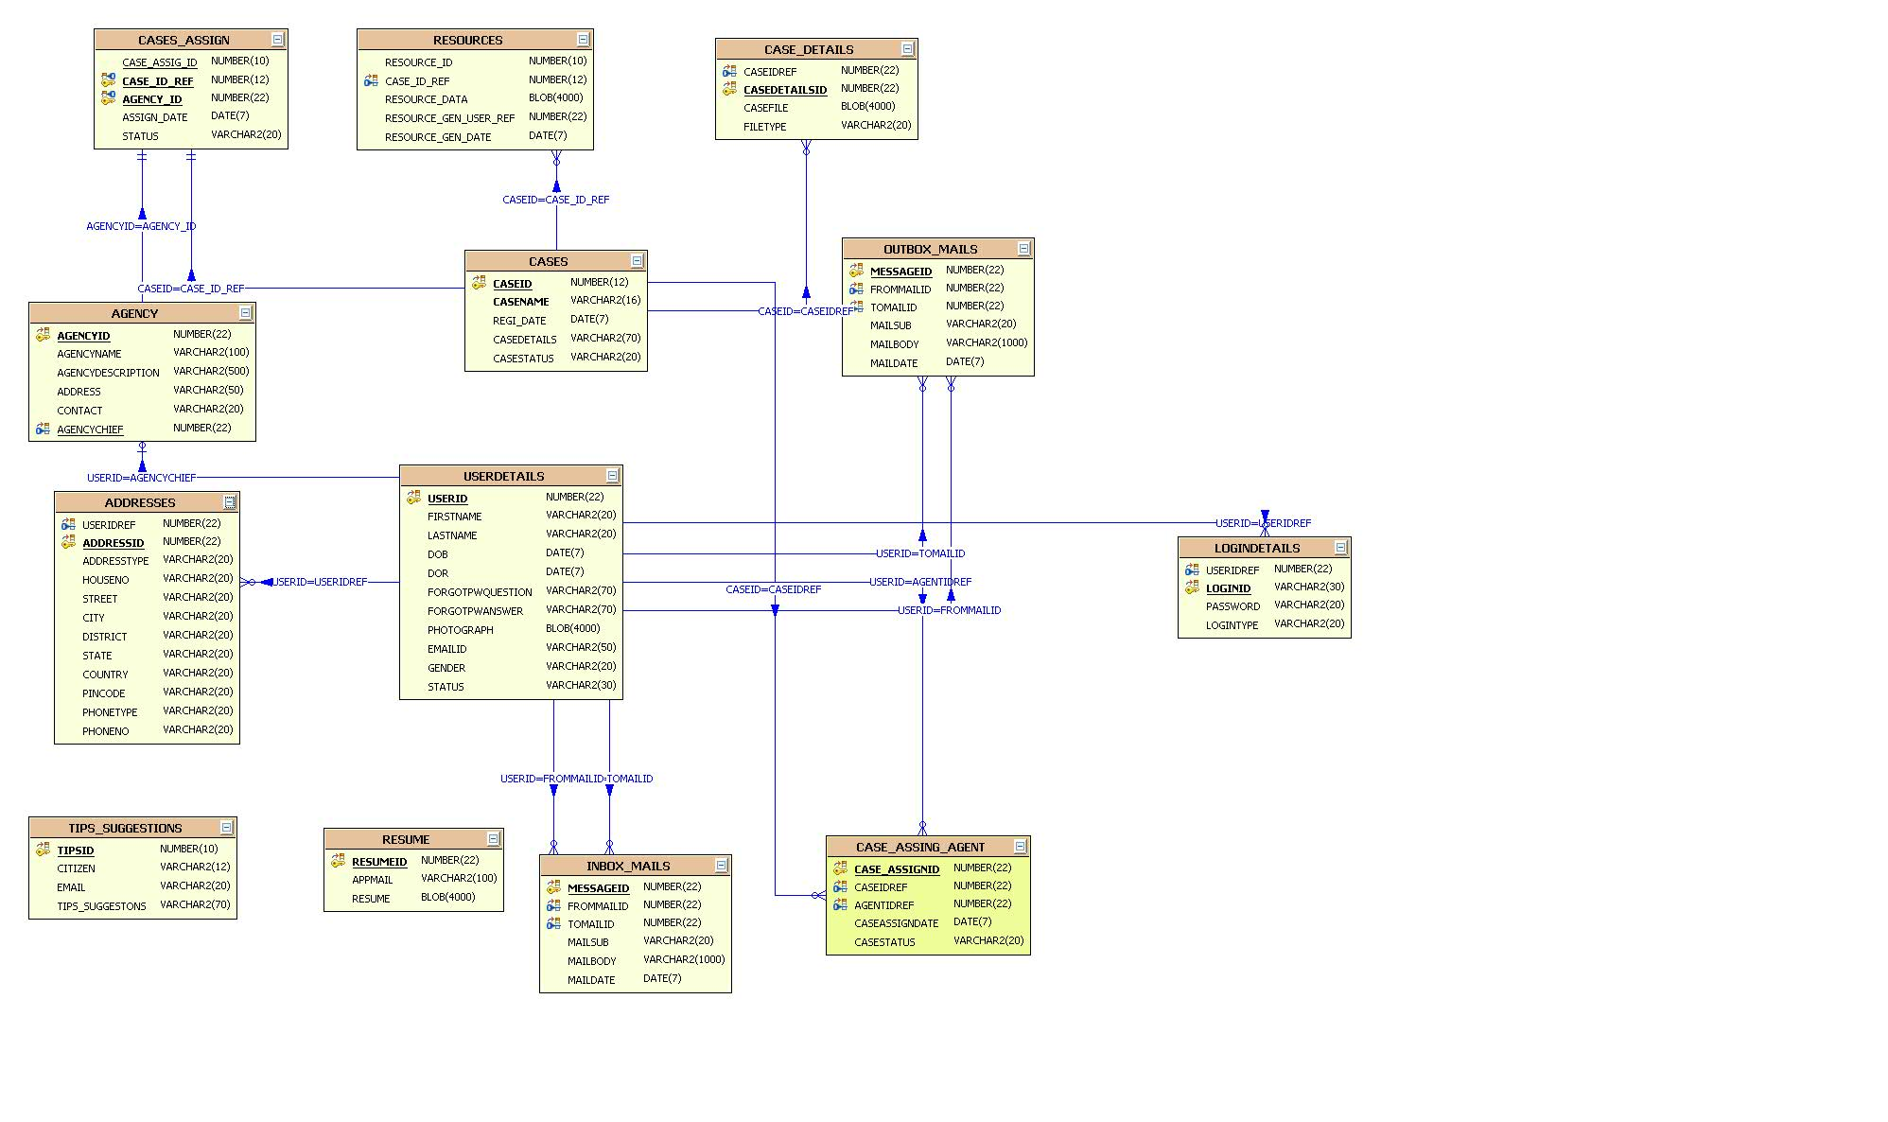

Slide 9
DATA FLOW DIAGRAM
DFDs are the model of the proposed system. They clearly should show the requirements on which the new system should be built. Later during design activity this is taken as the basis for drawing the system’s structure charts.

Slide 10
Context Level Data Flow Diagram

Slide 11
Minister: Data Flow Diagram

Slide 13
Agent Chief Data Flow Diagram Diagram

Slide 15
What is UML?
UML → “Unified Modeling Language”
Language: express idea, not a methodology
Modeling: Describing a software system at a high level of abstraction
Unified: UML has become a world standard
Object Management Group (OMG): www.omg.org

Slide 16
Types of UML Diagrams:
Use Case Diagram
Class Diagram
Sequence Diagram
Activity Diagram
Component Diagram

Slide 17
1. Use-Case Diagrams
A use-case diagram is a set of use cases
A use case is a model of the interaction between
External users of a software product (actors) and
The software product itself
describing a set of user scenarios
capturing user requirements
contract between end user and software developers

Slide 18
System
Agency‘s chief
Agent
Evidences Transferring in Secret Intelligence Agencies
Ministry of Defence
Citizen

Slide 19
Defiance Ministry Use Case Diagram:

Slide 20
Agency chief Case Diagram:

Slide 21
Agent Use Case Diagram :

Slide 22
Citizen Usecase Diagram
view success stories
view job resources
citizen
tips & suggesition
View services

Slide 23
2. Class Diagram
Class diagrams describe the structure of the system in terms of classes and objects. The servlet api class diagram will be as follows.
Name
Account_Name
- Customer_Name
- Balance
Attributes
+addFunds( )
+withDraw( )
+transfer( )
Operations

Slide 24
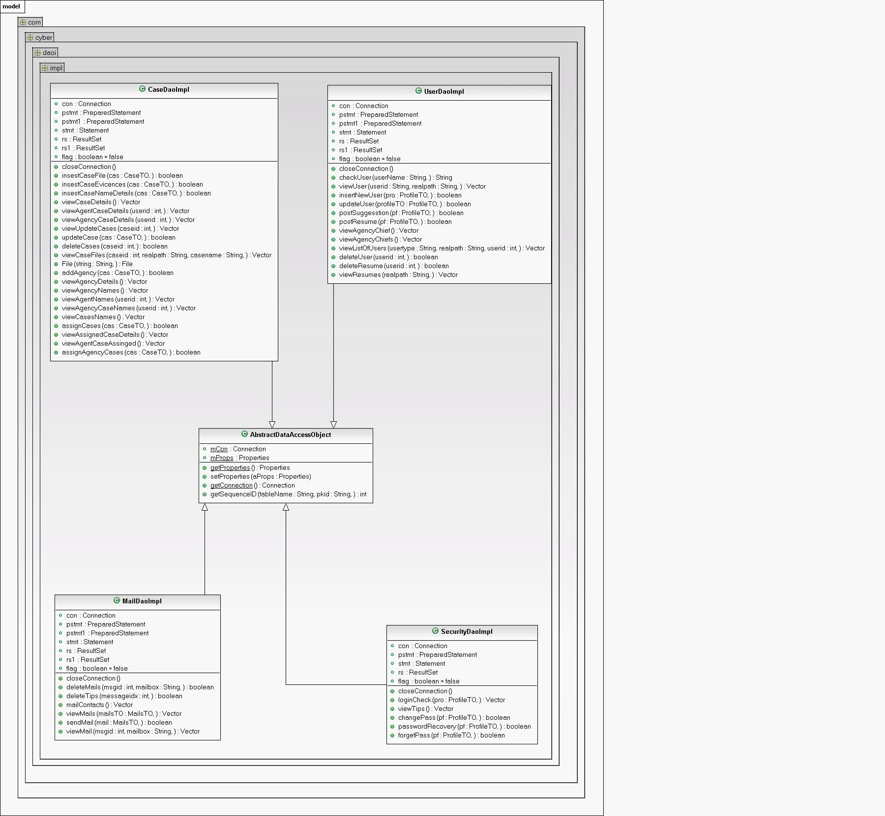

Slide 25
3. Sequence Diagram
Sequence diagrams demonstrate the behavior of objects in a use case by describing the objects and the messages they pass.
The horizontal dimension shows the objects participating in the interaction.
The vertical arrangement of messages indicates their order.
The labels may contain the seq. # to indicate concurrency.

Slide 26
User-Level Sequence Diagrams DefenceMinistry sequence Diagram:

Slide 27
AgencyChief sequence Diagram:

Slide 28
4.Activity Diagram
An activity diagram illustrates the dynamic nature of a system by modeling the flow of control from activity to activity. An activity represents an operation on some class in the system that results in a change in the state of the system. Typically, activity diagrams are used to model workflow or business processes and internal operation. Because an activity diagram is a special kind of state chart diagram, it uses some of the same modeling conventions

Slide 29
Activity Diagram for Secret Agency’s Chief:

Slide 30
Activity Diagram for Agent:

Slide 31
Activity Diagram for Citizen:
citizen
successfulstories
tips & suggestions
Job information
viewStries
tips & suuggestions
Activity3

